Slide 1
Professional Scope and Standards
A Review for Oncology Certification Exam
Nellee H. Fine, BSN, MA, RN, AOCN
Fall 2022

Slide 2
DISCLOSURES
Nellee Fine discloses that she does not have a conflict of interest
relative to this educational activity in the form of any financial interests,
arrangements, or affiliations.

Slide 3
Certification Makes a Difference®
Patients value knowledgeable nurses
Employers want qualified and experienced staff
Nurses want to validate their level of expertise
Notes:
Just caring for cancer patients does not MAKE an Oncology Nurse!
Oncology nursing certification validates a nurse has specialized knowledge and experience in cancer care. Certification makes a difference - to patients who want knowledgeable nurses, to employers who want qualified and experienced staff, and to individual nurses who want to demonstrate their knowledge.

Slide 4
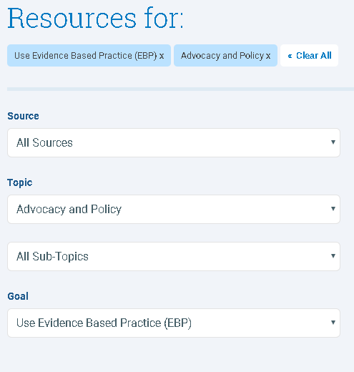
ONS and ONCC Resources for CEUs / Certification
OCN Review Bundle (online)
4 courses online $$
ONS has FREE continuing education resources: Explore Resources (link)
ONCC has the Big List of FREE nursing continuing education (CE) from many websites, journals, and organizations.
Explore….. https://www.oncc.org/files/Big List_29.pdf (link)
Other resources:
ONCC Practice Test free (link)
OCN practice tests on the ONS website $$
Notes:
Your preparation for the exam should start with
OCN TEST Content Outline (aka the test blueprint)
This outline has weighted the broad topics that are covered on the exam.
Since everyone has unique experience and skills, this list should help you to determine which areas of oncology knowledge you need to review or learn.
You can purchase the OCN Review Bundle or explore a number of FREE education
Tap the EXPLORE RESOURCES link OR also look at the ONCC BIG LIST of free CNE.
There Free test questions or if you wish you can pay for practice tests.
4

Slide 5
Oncology Certified Nurse (OCN®) Test Content Outline
Scientific basis
Site-specific cancer considerations
Scope and Standards of Practice 17%
Accreditation (e.g., The Joint Commission, QOPI, MAGNET)
Collaboration
Communication
Culturally congruent care
Environmental health (e.g., safety, personal protective equipment, safe handling)
Ethics (e.g., patient advocacy)
Evidence-based practice and research
Leadership
Legal, license, and protection of practice (including documentation)
Professional practice evaluation
Quality of practice
Resource utilization
Self-care (e.g., managing compassion fatigue)
Standards of care (nursing process)
Notes:
2022 Oncology Certified Nurse (OCNⓇ) Test Content Outline has 3 major areas of oncology content.
Scientific basis of oncology nursing
Site specific cancers
Oncology Nursing Scope & Practice comprises 17% of the test questions.
I will be reviewing the “highlighted” topics in this presentation.
The remaining topics should be reviewed according to your knowledge deficits.

Slide 6
Professional Scope and Standards of Practice
3 Pillars of Nursing’s Scope of Practice
National
State
Specialty Organization: ONS
NATIONAL
STATE
SPECIALTY
Notes:
Professional nursing practice is articulated by the Am. Nurses Association:
Scope of practice describes the services that a qualified health professional is deemed competent to perform, and permitted to undertake – in keeping with the terms of their professional license.
The State Board of Nursing further regulates activities that a nurse may or may not do.
What level of education is required and does you license cover the role or activity?
What skills, preparation or resources are needed for the activity?
Does the Nurse Practice Act or your State Board of Registration speak to the activity?
Nurses who specialize in a specific area of nursing such a critical care, or oncology, need to look to their national professional organizations to provide practice guidelines, specialty competencies, and certification.

Slide 7
ANA Scope of Nursing Practice
Who: Registered Nurses (RN) and Advanced Practice Registered Nurses (APRN) comprise the “who” constituency and have been educated, titled, and maintain active licensure to practice nursing.
What: Nursing is the
Protection,
Promotion, and
Optimization of health and abilities;
Prevention of illness and injury;
Facilitation of healing;
Alleviation of suffering through the diagnosis;
Treatment of human response; and
Advocacy in the care of individuals, families, groups, communities, and populations.
Why: The profession exists to achieve the most positive patient outcomes in keeping with nursing’s social contract and obligation to society.
Notes:
ANA Scope of practice states who may practice nursing,
what nursing is: what is it that nurses do,
and why nursing is important:
as a profession we exist to achieve the most positive patient outcomes in keeping with nursing’s social contract and obligation to society.

Slide 8
Specialty: Oncology Nursing Practice
ONS recognizes that the current healthcare environment, is a rapidly evolving science, with expansive research which….
“impacts patient care and delivery ....requiring oncology nurses to attain and maintain a high level of competency to adequately care for people with cancer.”
Your specialty organization mission:
Set evidence-based standards and guidelines for practice
Provide position statements on key issues,
Articulate the core competencies of an oncology nurse,
Provide evidence of that knowledge through the certification exam process.
Notes:
The specialty of oncology recognizes the current healthcare environment, is a rapidly evolving science, with expansive research which….
“impacts patient care and delivery ....
requiring oncology nurses to attain and maintain
a high level of competency to adequately care for people with cancer.”
The mission of ONS is to set EBP standards and guidelines
Take positions on key issues
Describe the core competencies of an oncology nurse and
Provide evidence of that knowledge through the certification exam process.

Slide 9
Oncology Nursing Society Professional Practice Foundations
Nursing Practice
Standards and Guidelines
Position Statements
Role Delineation
Advocacy
(active links)
Notes:
ONS describes 5 components which are the Foundation of Oncology Nursing Professional Practice.
Advocacy
Nursing Practice
Role Delineation
Standards and Guidelines
Position Statements
Please use the active links to explore these topics.

Slide 10
ONCOLOGY NURSING PRACTICE: Certification
ONCC's Definition of Oncology Nursing Practice:
may be work experience that is direct and/or indirect patient care in clinical practice, nursing administration, education, research, or consultation in the specialty represented by the credential.
The position MUST be filled by a Registered Nurse.
Nursing practice as eligibility criteria for certification and renewal requires a broad definition to reflect rapidly evolving roles across the cancer care continuum.
Effective January 1, 2021
https://www.oncc.org/files/NursingPractice2021.pdf
Notes:
Oncology Nursing is continuously “evolving” in areas of science, research, technology, and practice…..
ONCC's Definition of Oncology Nursing Practice:
may be work experience that is direct and/or indirect patient care in clinical practice, nursing administration, education, research, or consultation in the specialty represented by the credential.
The position MUST be filled by a Registered Nurse.
Practice hours are also a key requirement.

Slide 11
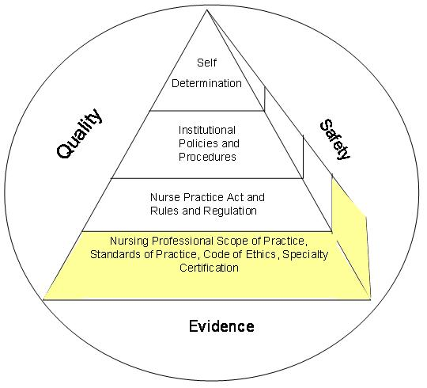
SCOPE OF ONCOLOGY NURSING PRACTICE:
Evidence-based nursing or health care literature
Practice policies and/or procedures
Education to safely perform procedures
Documented evidence of RNs current competence
Appropriate resources available
FOUNDATION of PRACTICE
*see handout “Scope of Practice Decision-making Framework”; Ballard, 2016
Notes:
This diagram illustrates that Quality, Safety and Evidence for practice encircle the pyramid of practice.
The foundation is the professional scope of practice that includes practice standards and guidelines, code of ethic and specialty certification.
The Nurse Practice Act provides the rules and regulations for our practice.
Your clinical setting provides specific policies and procedures for practice.
And above all this we determine to act or follow a specific order based on our experience and knowledge. Does your setting have the resources to safely perform the activity?

Slide 12
Oncology Nursing Society Professional Practice Foundations
Nursing Practice
Standards and Guidelines
Position Statements
Role Delineation
Advocacy
(active links)
Notes:
Foundation of Oncology Nursing Professional Practice includes these 5 components.
Advocacy
Nursing Practice
Role Delineation
Standards and Guidelines
Position Statements
The active links are provided for you to explore these important topics.

Slide 13
Competence vs. Competency
Competence a person’s general ability to do something successfully or efficiently.
ex. knowledge of NG tube insertion, general ability to perform
Competency is a person’s actual performance, ability to perform a task
ex. Insertion of NG tube skill is validated according to hospital policy
A person needs competence before he or she can achieve competency.
*Documentation of nursing competency is frequently required of accreditation agencies (i.e. American College of Surgeons and the Joint Commission), as part of the accreditation and re-accreditation process.
Notes:
For the exam you will need to be able to define and discern key concepts.
For example what is the difference between competence and competency.
Competence a person’s general ability to do something successfully or efficiently.
Competency is a person’s actual performance, ability to perform a certain task.
Joint Commission and other regulatory agencies often require documentation that supports the development and assessment of a nursing competency.
An example may be “how does your workplace document competency of a chemotherapy nurse?

Slide 14
Guidelines Versus Standards
Guidelines = Recommendations
Examples:
• NIOSH
• ASHP
• ONS
Not Enforceable
Standards = Requirements
Examples:
• Department of Health
• CMS
• The Joint Commission
Enforceable
Notes:
Another set of terms that you need to know are the differences between Guidelines and Standards
Guidelines are recommendations -
A standard is enforceable - usually by a regulatory agency

Slide 15
Guidelines Versus Standards
Ex. You find that your new practice setting does not require a MUGA scan prior to giving an anthracycline …
Is this an enforceable standard?
YES or NO
No, it is a guideline.
It is not enforceable,
but omission of this test is not the standard of practice.
Recommendation:
Communicate to prescriber that there is no MUGA ordered.
If no order for MUGA results - verify practice with pharmacy, to determine if this is an accepted practice of the institution.
Document that the prescriber was notified.
Resource: “Chemotherapy and Immunotherapy Guidelines and Recommendations for Practice”
Notes:
Another set of terms that you will need to know are the differences between Guidelines and Standards
Guidelines are recommendations.
An example of this is the Chemotherapy and Immunotherapy Guidelines and Recommendations for Practice
A Standard is enforceable - usually by a regulatory agency, and there may be direct or indirect monetary consequences for non-compliance.

Slide 16
Knowledge Check
Ex. At your new job you find that there is no policy nor documentation of education and competence requirement to administer antineoplastic chemotherapy.
Is this a problem?
Yes or No
Is this an enforceable standard?
YES, the lack of policy and documentation may result in a Joint Commission citation and the American College of Surgeons.
This is a standard that is enforceable by TJC.

Slide 17
USP <800> Hazardous Drugs—Handling in Healthcare Settings
U.S. Pharmacopeia (USP) is an independent organization is dedicated to medication quality and safety.
The USP published General Chapter <800> to limit occupational exposure to HDs to protect patients, health care personnel, and the environment from the effects of handling HDs.
This publication impacts Pharmacies and related services, including NURSING!
Notes:
The U.S. Pharmacopeia (USP) is an independent organization is dedicated to medication quality and safety and recent work has been to limit occupational exposure of Hazardous Drugs and to protect patients and the environment.
This publication impacts Pharmacies and related services, including NURSING!
USP <800> is a Standard! These requirements are linked to the ability of Pharmacies to dispense medications.
The Joint Commission has also adopted these practice standards in their accreditation surveys.

Slide 18
USP <800> Hazardous Drugs—Handling in Healthcare Settings
U.S. Pharmacopeia (USP) is an independent organization is dedicated to medication quality and safety.
The USP published General Chapter <800> to limit occupational exposure to HDs to protect patients, health care personnel, and the environment from the effects of handling HDs.
This publication impacts Pharmacies and related services, including NURSING!
Is USP <800> a Guideline
or a Standard?
✅ Standard !
Fines can be levied for noncompliance.
Notes:
The U.S. Pharmacopeia (USP) is an independent organization is dedicated to medication quality and safety and recent work has been to limit occupational exposure of Hazardous Drugs and to protect patients and the environment.
This publication impacts Pharmacies and related services, including NURSING!
USP <800> is a Standard! These requirements are linked to the ability of Pharmacies to dispense medications.
The Joint Commission has also adopted these practice standards in their accreditation surveys.

Slide 19
Guideline Versus Standard
USP 800:
This publication impacts Pharmacies and related services, including NURSING!
In your practice settings:
PPE* – double gloving
CSTD*s – closed system transfer devices
* Only USP 800 approved products
Notes:
The U.S. Pharmacopeia (USP) is an independent organization is dedicated to medication quality and safety and recent work has been to limit occupational exposure of Hazardous Drugs and to protect patients and the environment.
This publication impacts Pharmacies and related services, including NURSING!
USP <800> is a Standard! These requirements are linked to the ability of Pharmacies to dispense medications.
The Joint Commission has also adopted these practice standards in their accreditation surveys.

Slide 20
Review ONS Standards/Guidelines and Position Statements
6 Standards and Guidelines (link)
Access Device Standards
ASCO/ONS Chemotherapy Standards
Scope and Standards of Oncology Nursing Practice
Standards on Oncology Nursing Education
ONS Standard for Educating Nurses Who Administer Chemotherapy and Biotherapy
Chemotherapy / Immunotherapy Guidelines and Recommendations for Practice
Notes:
ONS has articulated many practice standards for oncology nursing.
You should familiarize yourself with the list and their content.

Slide 21
Oncology Nursing Society Professional Practice Foundations
Nursing Practice
Standards and Guidelines
Position Statements
Role Delineation
Advocacy
(active links)

Slide 22
Review ONS Standards/Guidelines and Position Statements
17 ONS Position Statements (link)
Tobacco
Nurses’ Role when a patient requests medical aid in dying
Use of E-cigarettes and Vaping
Cancer Pain Management, etc..
? Will ONS take a position on the continuing need for contraception and at times need for therapeutic abortion for cancer patients – given the recent leak from SCOTUS?
Notes:
ONS takes a stand on the healthcare issues that affect oncology nurses.
Each of our position statement is spurred by member interest and developed by a diverse, unbiased committee of experts, including the ONS Board of Directors.
You should familiarize yourself with the list and their content.
? Will ONS take a position on the continuing need for contraception and at times need for therapeutic abortion for cancer patients – given the recent leak from SCOTUS?

Slide 23
Oncology Nursing Society Professional Practice Foundations
Nursing Practice
Standards and Guidelines
Position Statements
Role Delineation
Advocacy
(active links)
Notes:
ONS has performed research and polling to determine the what, who, and where oncology nursing practice occurs.
Role delineation directly impacts competency to practice.

Slide 24
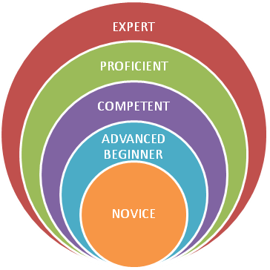
ONS Role Delineation Benner’s Model Stages of Clinical Competence
LEVELS OF NURSING EXPERIENCE
5 levels
Novice
Advanced beginner
Competent (eligibility for exam)
Proficient
Expert
Benner, P. (1982). From novice to expert. American Journal of Nursing, 82, 402–407.
Gaguski, M.; George, K.; Bruce, S.; et al. (2016). Oncology Nurse Generalist Competencies. CJON. 21(6) 679-687.
Notes:
Patricia Benner’s model for the stages of clinical competence is used as the foundation for the OCN Test.
ONS has identified the oncology nurse generalist competencies (see the active link) which outlines the base knowledge of an RN novice in oncology.
Novice is like your New grad or new non-onc hire: “Tell me what to do and I will do it”
Adv. Beginner: Begins to establish a to do list (able to prioritize)
Competent nurse has 2-3 y in a clinical area, begins to recognize patterns and clinical situations more quickly and accurately
Proficient nurse understands situations as whole parts. Learns from experience and modifies practice accordingly.
Expert nurse: has intuitive grasp and deep knowledge and experience, focuses on the whole picture, and recognizes subtle changes.
The expert nurse uses analytical tools even when they have no experience with a novel or unexpected event. (Benner, 1982)
Which level of clinical competence do you identify?

Slide 25
ONS Role Delineation Benner’s Model Stages of Clinical Competence
LEVELS OF NURSING EXPERIENCE
5 levels
Novice
Advanced beginner
Competent (eligibility for exam)
Proficient
Expert
ONS defined Oncology_Nurse_Generalist_Competencies_2016.pdf (link)
Notes:
Which level of clinical competence do you identify?
Please refer to the Oncology nurse Generalist Competencies article (active lin)

Slide 26
Knowledge Check
According to the ONS standards, involvement in evidenced based practice (EBP)….
is an expectation for nurses prepared at all levels.
requires participation in nursing research.

Slide 27
Knowledge Check
According to the ONS standards, involvement in evidenced based practice (EBP)….
is an expectation for nurses prepared at all levels.
requires participation in nursing research.
A.

Slide 28
Oncology Nursing Society Professional Practice Foundations
Nursing Practice
Standards and Guidelines
Position Statements
Role Delineation
Advocacy
(active links)

Slide 29
Principles of Professional Nursing Practice
"KNOW the CODE"
ANA Code of Ethics for Nurses (see handout)

Slide 30
Nursing Ethics
According to Gallup polls, nursing has ranked as the most honest and ethical profession in the past 20 years – each year.
(The only time nursing was not #1 was after 911 when the public ranked Firemen and Police before nurses.)

Slide 31
4 Main Principles of
Ethical Nursing Practice
Nonmaleficience
Justice
Beneficience
Autonomy
Actions guided by compassion.
Do
no
harm.
Each patient has the right to make his own decisions based on their beliefs and values.
The patient has a right to fair and impartial treatment
no matter the patient’s financial or insurance status, gender identity, age, or ethnicity.

Slide 32
Knowledge Check
Over coffee you hear a group of co-workers saying that the patient in room 708 is homeless and an alcoholic who keeps getting readmitted for his uncontrolled diabetes; and he does not deserve good quality care because of his past behaviors.
This is an example of a violation of which core ethical principle?

Slide 33
Knowledge Check
Over coffee you hear a group of co-workers saying that the patient in room 708 is homeless and an alcoholic who keeps getting readmitted for his uncontrolled diabetes; and he does not deserve good quality care because of his past behaviors.
This is an example of a violation of which core ethical principle?
Justice!
RN must treat all patients fairly and equally.

Slide 34
Nursing and the LAW
Notes:
While nursing as a career can be rewarding, providing care to others brings its own share of liability issues.
From False imprisonment, Disclosure of health information, or negligent act such as failure to follow a provider order.
Knowledge of these common pitfalls can help protect your license and your career.

Slide 35
Nurses and the Law: Legal Terms
“Professional Liability”
the state of being responsible for something.
“Standard of Care”:
What a reasonably prudent nurse would have done in the same or similar circumstance.
Notes:
It is important that you have an understanding of common legal terms such as professional liability : the state of being responsible for something.
And Negligence - which is the failure to provide a “standard of care that could be reasonably expected in a specific situation.
Prior to the 1980’s, nurses were rarely named individually in law suits.
Common defense was that they were “just following orders”.
However Legal climate since sees Nursing as an independent, profession
and an employee of a hospital or institution.

Slide 36
Professional Negligence
Professional Negligence is a breach of duty of care between professionals and their clients.
A Nurses’ liability is called “Negligence”: failure to provide standard of care that could be reasonably expected in a specific situation.
The failure to use reasonable care, or
Careless act or omission by an individual that results in harm to the person to whom the caregiver has a duty.
Negligent conduct can occur by acts of commission (an action) or omission (inaction).
Notes:
Professional Negligence is a breach of duty of care between professionals and their clients.
A Nurses’ liability is called “Negligence” which is a failure to provide a standard of care.
Negligent conduct can occur by acts of commission = an action or omission - something left undone

Slide 37
Professional Negligence: Examples of Litigation
Did not use medical equipment properly
Violated the standard of care
Failure to document
Performing duties while under the influence
Improper administer of medication
Failure to communicate
Failure to monitor and evaluate a patient
Failure to educate the patient/caregiver
Lippincott Nursing Center
Healthcaresupport.com
Notes:
Examples of Professional Negligence: (these are real life examples)
Medical Equipment: Tube feeding attached to a central line
Violation of standard of care: LPN administering IV chemotherapy
Failure to document - med allergies - and administers drug
Administering a vesicant without checking bld rtn
Failure to monitor patient for ordered duration ex. post 1st dose of pertuzumab
Failure to educate ex. To instruct a patient to avoid driving while taking medications that causes sedation.

Slide 38
Common Sources of Nurse Litigation
Medication errors
Failure to follow policies, procedures, and treatment protocols
Failure to Educate Patient/Family
Failure to Document and Report Critical Clinical Information
Failure to Follow the Chain of Command / Communicate

Slide 39
Four Elements of Nursing Malpractice
Duty: Once the nurse–patient relationship is established, the nurse has a legal duty to provide the standard of nursing care.
Breach: The plaintiff’s attorney must next prove that the nurse breached the duty to provide the standard of care.
Proximate Cause:
The plaintiff must prove that the failure to provide the standard of care is the proximate cause or “cause in fact” of the injury.
Harm or Damages:
The plaintiff must prove that he or she was injured and sustained damages. Damages entitle the plaintiff to seek compensation for injuries.
* All 4 elements must be met for the prosecution to prevail.
Notes:
For nursing malpractice to prevail all 4 of the following elements must be met for the prosecution to prevail against a nurse.
Duty: Once the nurse–patient relationship is established, the nurse has a legal duty to provide the standard of nursing care.
Breach: The plaintiff’s attorney must next prove that the nurse breached the duty to provide the standard of care.
Proximate Cause: The plaintiff must prove that the failure to provide the standard of care is the proximate cause or “cause in fact” of the injury.
Harm or Damages: The plaintiff must prove that he or she was injured and sustained damages. Damages entitle the plaintiff to seek compensation for injuries.

Slide 40
CASE STUDY #1: Patient/Family Education
Unfortunately, patient was
readmitted to the ER 48 hours later obtunded.
He was found to have multiple patches on his torso because
Mrs. Peters did not understand the change in frequency to q 3d, and how to remove the patch.
She had applied a new patch Q 12h and had not removed the prior patches.
Is this professional negligence?
or
Is this a criminal act?
Mr. Peters 75y.o. with Esophageal cancer had been managed well by his wife with MS Contin® 60mg BID po.
But now presents with obstruction of his esophagus. He is admitted for a PEG tube and is now ordered for Duragesic® 25 mcg/h q 3d.
The RN taught his wife how to apply the patch and had her return demonstration.
Notes:
Is this professional negligence?
Is this a criminal act?

Slide 41
Professional negligence?
YES
The RN did not validate/document that the wife understood all components of safe Duragesic® administration.
Was there a breach of duty between the nurse and the patient’s caregiver
AND
Was there a careless act of omission by the RN that resulted in harm to the person to whom the caregiver has a duty (to teach safe use of medication)
The patient recovered;
and there was no criminal action for this incident.
Notes:
Is this professional negligence?
Is this a criminal act?

Slide 42
CASE STUDY #2 : Medication Error
December 2017 an Emory Hospital float RN has an order to premedicate a r/o cranial bleed patient with Versed IV for a followup MRI.
The RN overrides the medication dispensing system and mistakenly administers a dose of vecuronium (a paralyzing agent).
The nurse assists in resuscitation efforts – patient transfers to ICU, dies a few days later.
Is this professional negligence?
Are the elements of malpractice present?
Duty
Breach of Care
Proximate Cause
Harm/Damages
Notes:
2019 RN Radonda Vaught overrides medication dispensing system and administers a fatal dose of medication confused the
anti-anxiety medication, midazolam (brand name Versed) for vecuronium, a paralytic drug
Is this professional negligence?
Is this a criminal act?

Slide 43
CASE STUDY #2: Medication Error
Is this professional negligence?
YES!
The RN accepted responsibility of care (Duty/Proximate Cause) of the patient
But did not follow hospital policy and safety standards by overriding the safety medication dispensing unit.
Breach of Care Standard:
“What would a reasonably prudent nurse do in the same or similar circumstance?”
Safety measures were overrided
No double check of High Risk IV medication – policy of hospital.
Notes:
However The state health department investigation, which concluded in October 2018, did not revoke Vaught's nursing license.
The CMS report emphasized the hospital's responsibility in the mistake.
Is this a criminal act?
Well the RN was arrested and charged with reckless homicide and abuse and soon after was
Is this criminalization of a medication error?
Should all errors incur punishment or
should emphasis be placed on learning from the mistake and preventing future errors?

Slide 44
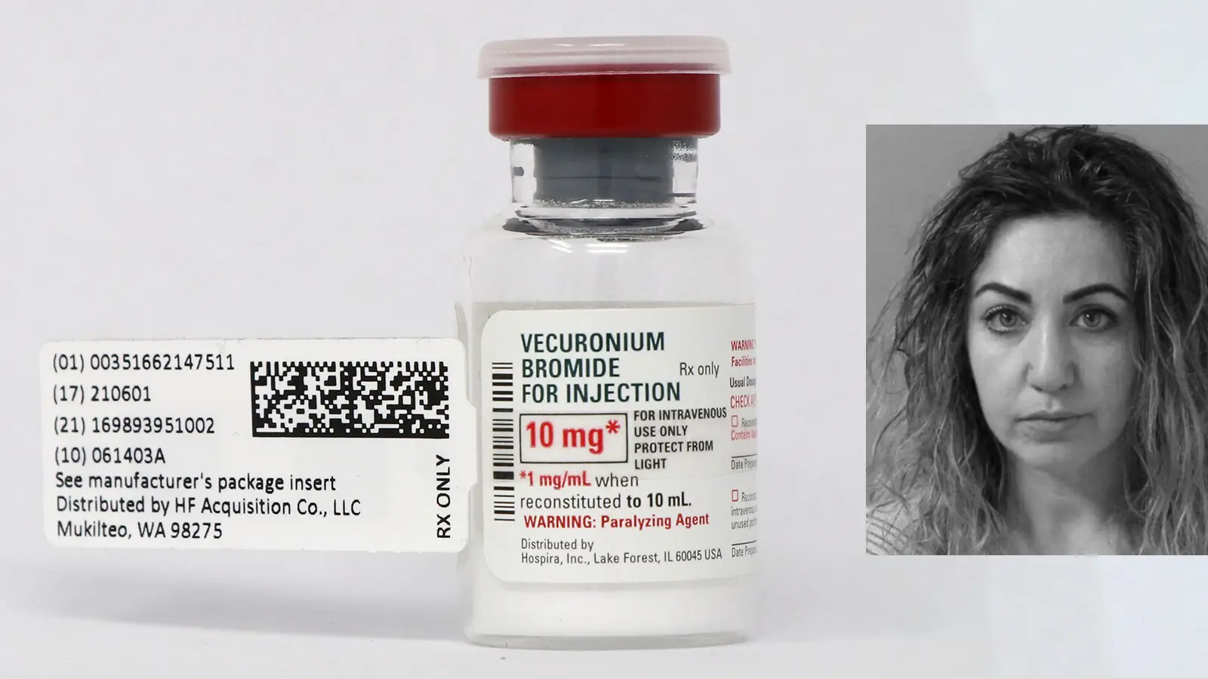
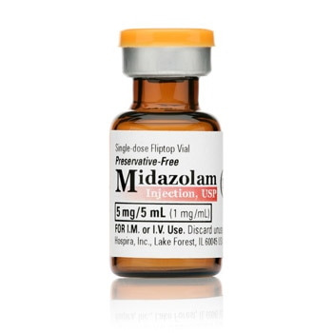
Real Consequences
Hospital terminated RN.
State did NOT immediately revoke the RNs license, only after criminal charges were sought.
CMS stated the hospital was also at fault for failing to ensure a safe patient environment.
ANA said that the hospital was guilty of criminalizing a medication error.
NOTE:
It’s unusual for health care providers to be charged with a crime after a medical mistake that didn't involve:
malicious intent or intoxication.
Notes:
The hospital terminated the RN.
The state did not revoke the RNs license.
CMS stated the hospital was also at fault for failing to ensure a safe patient environment.
Is this criminalization of a medication error?
ANA said YES.
It’s unusual for health care providers to be charged with a crime after a medical mistake that didn't involve malicious intent or intoxication.
The criminalization of medication errors will have a chilling effect on HCP willingness to REPORT errors.
This RN plead not guilty - trial to be continued later in 2020.

Slide 45
UPDATE: Radonda Vaught
At trial she placed blame on the hospital for allowing ease of overrides.
She lost her RN license to practice in July, 2021.
The court found her guilty of gross neglect of an impaired adult and negligent homicide.
She faces three to six years in prison for neglect and one to two years for negligent homicide.
No charges have been brought against the hospital or it’s leadership.
Photo; NPR and KHN
NOTE: it’s unusual for health care providers to be charged with a crime after a medical mistake that didn't involve:
malicious intent or intoxication.

Slide 46
Hospitals have the potential for serious failures.
Hospitals are or should be High Reliability Organizations (HROs) they:
# understand that they have a potential for catastrophic failure ……
# have a preoccupation with failure,
# look deeper into the causes of an error!
Is this criminalization of a medication errors?
Will it have a chilling effect on HCPs willingness to REPORT Future Errors?
OR
Should emphasis be placed on learning from the mistake and preventing future errors?

Slide 47
Knowledge Check
Complete the sentence:
Professional certification…
A. Requires employers to provide incentives to pursue certification.
B. Establishes standards of performance in cancer care that will serve to improve client outcomes.
C. Upgrades nursing services provided by the institution in which the certified nurse practices.
D. Provides the public with assurance that the certified nurse has the knowledge and qualifications to practice in the role.
D
Provides the public with assurance that the certified nurse has the knowledge and qualifications to practice in the role.

Slide 48
PROFESSIONAL DECISION MAKING
“ONCOLOGY NURSING DILEMMAS”
Know Your Resources:
Specialty Standards
Code of Ethics
Scope of Practice

Slide 49
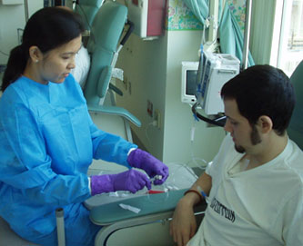
Oncology Nursing Dilemmas: Safe Handling
You have been an ONS Chemotherapy Nurse provider for 2 years. Recently you accepted a position in a hematology/oncology community practice.
During orientation you find that the practice does not follow ONS/ASCO guidelines for Safe Handling.
Specifically, none of your colleagues are using double chemo gloves.
In addition, they are “spiking” chemo infusion bags outside of a biological safety cabinet (BSC).
What would you do?

Slide 50
Oncology Nursing Dilemmas: Safe Handling
Know your specialty resources:
2016 Updated ASCO/ONS Chemotherapy Administration Safety Standards
www.asco.org/chemo-standards
USP <800> Hazardous Drugs – Handling in Healthcare Settings http://www.usp.org/sites/default/files/usp/document/our-work/healthcare-quality-safety/general-chapter-800.pdf
Polovich M.; ed. (2018) Safe Handling of Hazardous Drugs. Pittsburgh, PA, Oncology Nursing Society. 3rd edition
Know the Code:
Promotes/advocates for Health & Safety of Patient (Prov. 3)
Duties to self as to others (Prov. 5)

Slide 51
Oncology Nursing Dilemmas: Safe Handling
Know your specialty resources:
2016 Updated ASCO/ONS Chemotherapy Administration Safety Standards
www.asco.org/chemo-standards
USP <800> Hazardous Drugs – Handling in Healthcare Settings http://www.usp.org/sites/default/files/usp/document/our-work/healthcare-quality-safety/general-chapter-800.pdf
Polovich M.; ed. (2018) Safe Handling of Hazardous Drugs. Pittsburgh, PA, Oncology Nursing Society. 3rd edition
Know the Code:
Promotes/advocates for Health & Safety of Patient (Prov. 3)
Duties to self as to others (Prov. 5)

Slide 52
Oncology Nursing Dilemmas
Mrs. Hopkins is a 55 y.o. female bank executive diagnosed with stage III epithelial ovarian cancer. She was treated with carboplatin/paclitaxel 18 mos. ago and achieved complete clinical response.
She had a difficult time with the regimen (protracted nausea, electrolyte imbalance, weight loss, fatigue).
Recently, she was found to have recurrence. You are assigned to treat her. She is to re-start carboplatin/paclitaxel. You are told she is upset and nervous, waiting in the infusion room.
You review the orders and required labs are in normal range.
What else do you need to check?
Informed Consent!

Slide 53
Oncology Nursing Dilemmas: Informed Consent
The only consent you can find is from 18 mos. ago …..
What do you do?
Check hospital policy – “informed consent is valid for 12 mos. or until the ordered cycles are complete”
You contact the attending, who is busy and says “Just have her sign a duplicate consent.”
Can you (a staff RN) obtain an informed consent?
No, this is not within a registered nurses’ scope of practice.
(note: some states permit an APRN to obtain consent)
Know the CODE:
Self-determination (Prov. 1)
Patient Advocacy (Prov. 2)

Slide 54
Oncology Nursing Dilemmas: Informed Consent
Knowing that you, as a staff RN, cannot obtain an informed consent, you call the provider who tells you that the patient already signed a new consent yesterday! Just find it!
A short time later, a clinic assistant brings the consent to you - there was a delay in scanning into the EHR.
You view the form for all of the required elements in your hospital policy for informed consents.
Date
Signatures
Treatment regimen
Side effects
Signatures

Slide 55
Oncology Nursing Dilemmas: Informed Consent
Can you proceed with the treatment?
NO – You must verify that the patient is willing to proceed with the planned treatment.
Mrs. Hopkins is quite distressed and anxious that she will not tolerate the regimen well, and this will affect her work/family life. She is reluctant to proceed.
What do you do?
Reassure her you will HOLD TREATMENT
Contact the provider to review the plan of treatment with her.
Through these actions you are supporting her right for
“Self-determination” and demonstrating
“Patient Advocacy”!

Slide 56
Oncology Nursing Dilemmas: Scope of Practice
You are working in a busy heme/onc infusion center.
A provider is running late in clinic. He orders you to treat an Acute Lymphoblastic Leukemia (ALL) patient who is due for the 4th dose of IT methotrexate today.
What do you do?
Check hospital policy?

Slide 57
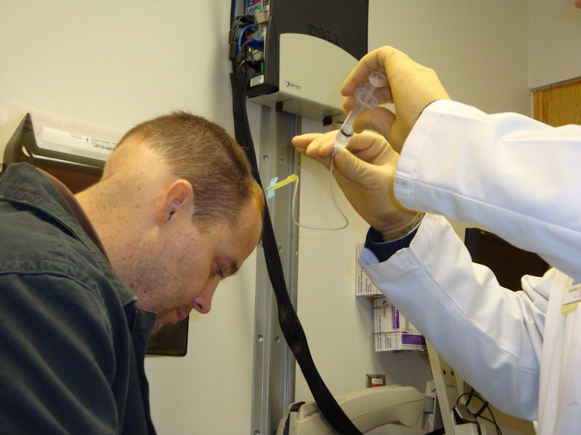
Oncology Nursing Dilemmas: Scope of Practice
How do I check to see if this skill is within a RN scope of practice?
State Board of Nursing Registration
Hospital Policy & Procedure Manual
Administration of IT chemotherapy is an advanced practice skill.
Providers /APRNs hospitals require knowledge and skill verification of competency.
You decline to administer the IT chemotherapy - it is not within your scope of practice.
Know the CODE:
Authority, Accountability, and Responsibility for Nursing Practice (Prov. 4)

Slide 58
Oncology Nursing Dilemmas: Practice Standards
You are a new employee in a small community hospital. You have an order to administer Oncovin 2 mg IV.
You review the order.
The drug is indicated for the patient condition and labs are in normal range.
The patient has a newly placed IV in the right forearm with a good blood return.
The drug arrives with proper dose and labels – but it is in a small 3mL syringe.

Slide 59
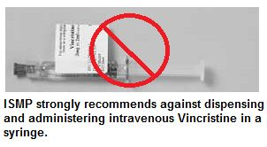
Oncology Nursing Dilemmas: Standards of Practice
What do you do?
Speak to Oncology Lead Pharmacist for practice remediation.
Document incident on a safety report.

Slide 60
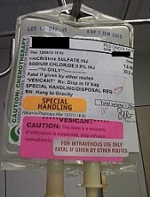
Oncology Nursing Dilemmas: Standards of Practice
Best practice:
All doses of Oncovin are to be diluted in a 50mL mini bag (not a syringe) over 5-10min.
(2005) National Medication Alert
ONS/ASCO Guidelines for Chemotherapy Administration

Slide 61
Thank you!
Wishing you all success on your pathway to Oncology Nursing Expertise!

Slide 62
Professional Scope and Standards
References
American Nurses Association. (2015). Code of ethics for nurses with interpretive statements. Accessed from: https://homecaremissouri.org/mahc/documents/CodeofEthicswInterpretiveStatements20141.pdf
American Nurses Association. (2015). Nursing: Scope and Standards of Practice, Third Edition. Silver Spring, Maryland: Nursebooks.org.
Ballard, Karen; Haagenson, D.; Christiansen, L. et al. (2016). Scope of Nursing Practice Decision-Making Framework. Journal of Nursing Regulation. 7(3)19-21.
Benner, P. (1982). From novice to expert. American Journal of Nursing, 82, 402–407.
Gaguski, M.; George, K.; Bruce, S.; et al. (2016). Oncology Nurse Generalist Competencies. CJON. 21(6) 679-687.
Mahon, S. (2018) Study Guide for the Core Curriculum for Oncology Nursing. St. Louis, MO. (5th edition)
National Academies of Sciences, Engineering, and Medicine. (2016). Assessing progress on the Institute of Medicine report The Future of Nursing. Washington, DC: National Academies Press.
Polovich M.; ed. (2018) Safe Handling of Hazardous Drugs. Pittsburgh, PA, Oncology Nursing Society. 3rd edition
Roach, M.S. (2002). Caring, the human mode of being: A blueprint for the health professions (2nd rev. ed.) Ottawa, Canada: Canadian Hospital Association Press.
“The Elements of a Nursing Malpractice”. AJN. July, 2019; September, 2019; November, 2019; March, 2020.
USP <800> Hazardous Drugs – Handling in Healthcare Settings http://www.usp.org/sites/default/files/usp/document/our-work/healthcare-quality-safety/general-chapter-800.pdf
2016 Updated ASCO/ONS Chemotherapy Administration Safety Standards
www.asco.org/chemo-standards

